Slide 1
Mobile Live Tracking
Live tracking and monitoring system

Slide 2
Features
The app will send coordinates if location is changed.
The app will send the alert to the central server if required.
The Application will be an online application and can be accessed from anywhere using internet.
The application will be a web GIS based Application showing the polling booths, polling areas and all other relevant layers like road, railways, police station etc.

Slide 3
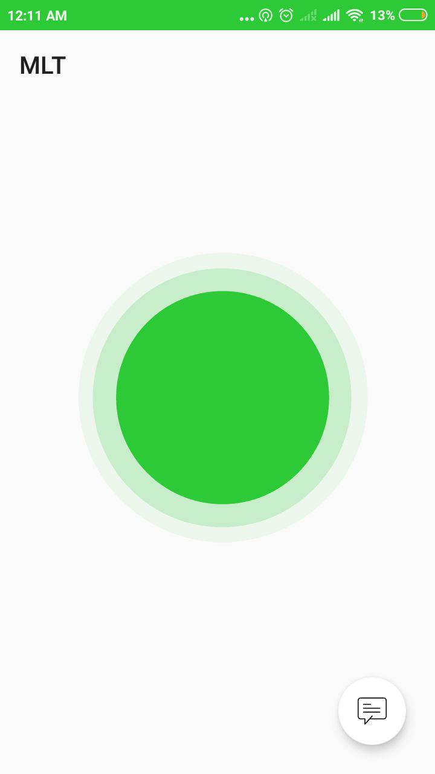
MLT App
Green indicates normal tracking mode active

Slide 4
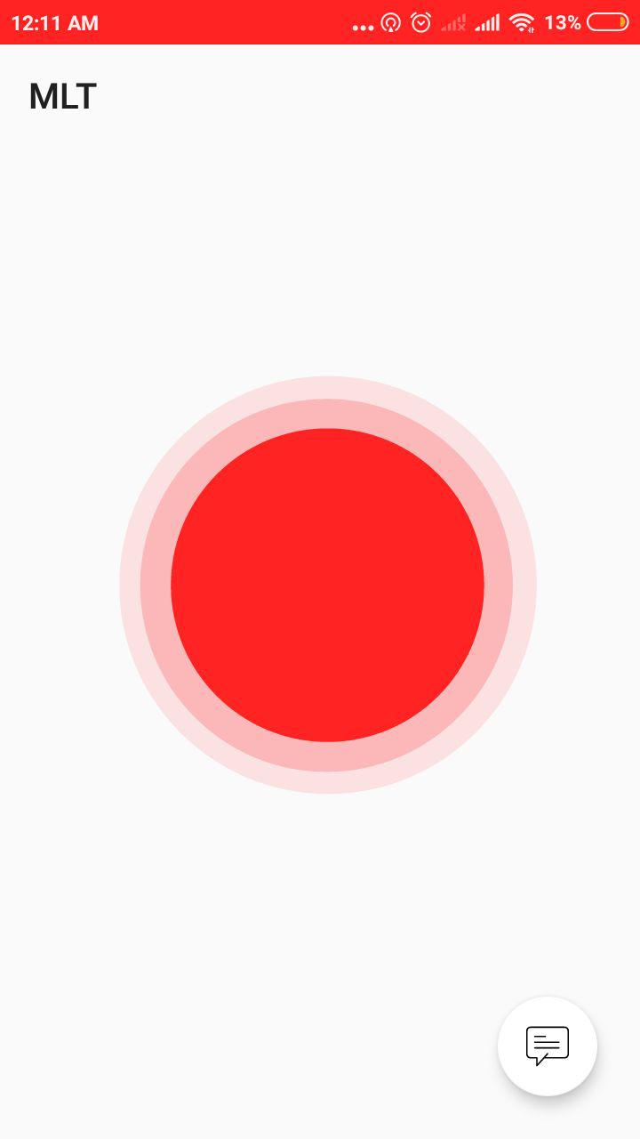
MLT App
Red indicates alter tracking mode active

Slide 5
MLT Tracking Dashboard

