Slide 1
Person with Disability (PWD)

Slide 2
Introduction
Management System for PwD Voters, Which is help to authority as well as all disable voters to cast their vote on the day of poll.

Slide 3
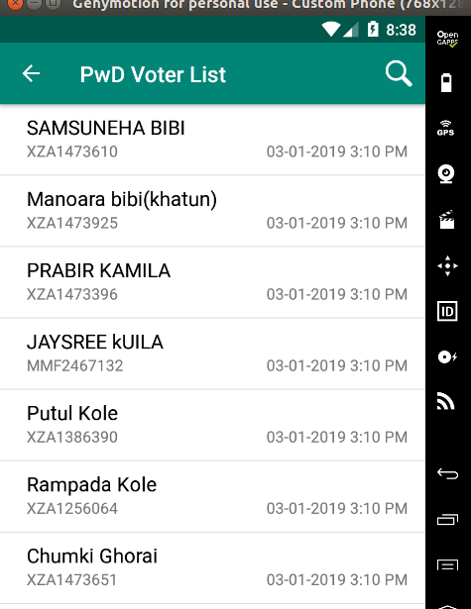
PWD Voters List
List of All PWD voters with their Name and Epic number

Slide 4
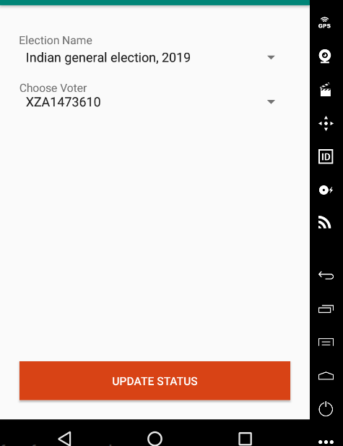
View PWD Epic Number to poll
BLO will update the casting status of all PWD voters after selecting Election name and Epic number .

Slide 5
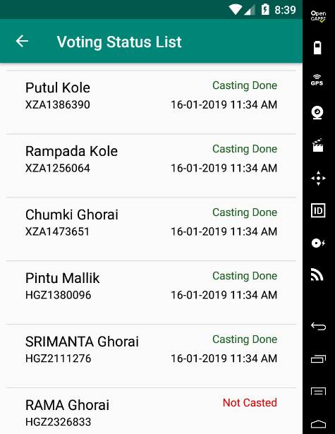
Casting Status of PWD Voters
From here Presiding Officer will view the update casting status of all PWD Voters.
Presiding Officer will come to know how many PWD Voter already casted their vote and how many still not done.

