Slide 1
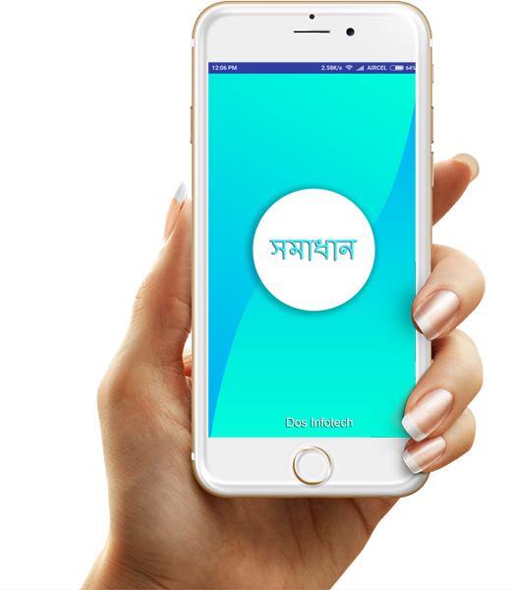
E - Services' for every municipal citizen

Slide 2
Introductions
Municipal Pariseba app provides municipal services directly from the your
home without visiting your municipality several time.
One time registration
Request for services from mobile phone
Received certificate /document from municipality

Slide 3
Advantages
Fast & Efficient
Request for services faster & Efficiently.
Save Time
No need to visit your municipality thousand times &
go through thousands of paper work.
Save Paper
Digital complaint so no need to waist papers on each complaint.

Slide 4
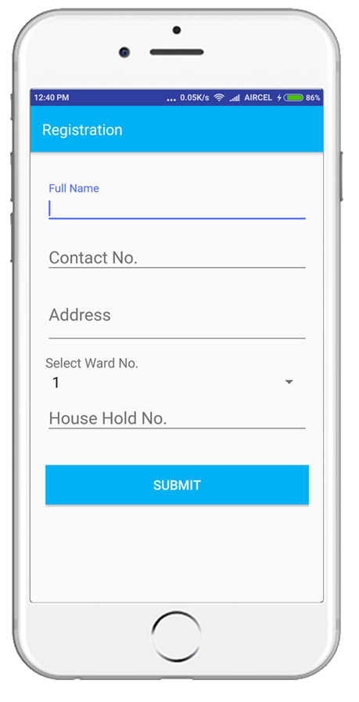
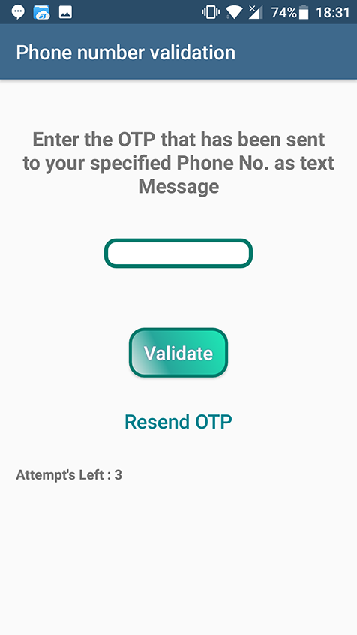
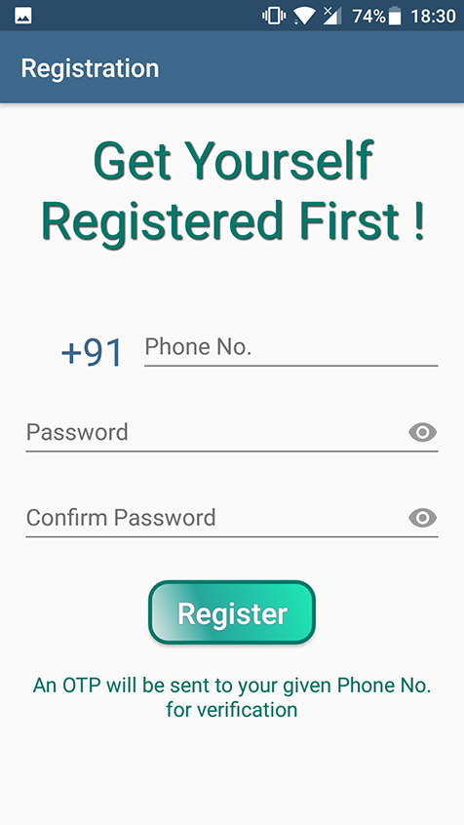
Registration
Easy registration with mobile number.

Slide 5
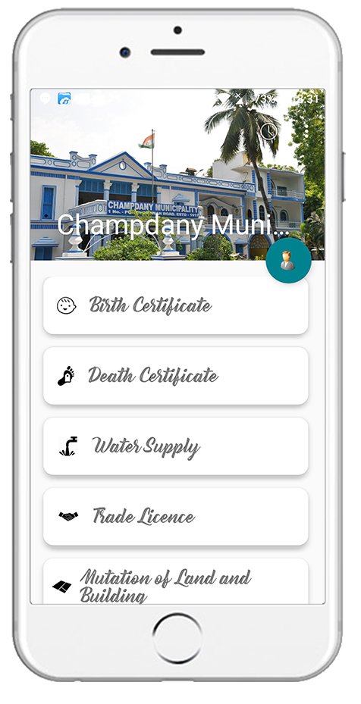
Select require services
Select a service that you would like to request

